Slide 1

LawGPT: Enhancing Legal Research with AI-Powered Multi-PDF Analysis
Sairudra More – 21BCE1389
Hritam Bose – 21BCE1386
Dr. Sharmila Devi S

Slide 2

Area of the Project
1. Artificial Intelligence & Legal Tech:
Leveraging AI to streamline legal research and question-answering processes.
2. Document Processing:
Handling and analyzing multiple complex legal documents in PDF format to extract relevant information and provide accurate responses.
3. Natural Language Processing (NLP):
Implementing NLP techniques to interpret legal language and deliver precise, context-aware answers based on user queries
4. User Interface Design:
Developing an intuitive and accessible interface with Streamlit to ensure ease of use for legal professionals and others seeking legal insights.

Slide 3

Background of the Problem
1. Complexity of Legal Research:
Legal research involves navigating vast amounts of documents, often leading to time-consuming processes.
2. Document Overload:
Legal professionals deal with multiple PDFs, making it challenging to extract relevant information quickly.
3. Need for Precision:
Accurate and context-aware legal answers are crucial, but manual searching can lead to errors.
4. Technology Gap:
Existing tools often lack the ability to process and analyze multiple legal documents effectively.

Slide 4

Problem Statement
1. Challenge:
Legal professionals face difficulties in efficiently extracting relevant information from multiple legal documents.
2. Impact:
The process is time-consuming, prone to errors, and lacks precision.
3. Goal:
Develop an AI-powered solution to streamline legal research and provide accurate, context-aware answers based on multiple PDFs for easu access for the public

Slide 5

Introduction
The legal industry is undergoing a transformation with the integration of AI technologies. LawBots, or AI-powered legal assistants, are becoming increasingly popular for their ability to provide legal information, streamline processes, and improve access to justice.

Slide 6

The Need for a LawBot
Access to legal information and assistance is a fundamental right, yet many individuals face barriers such as high costs, lack of knowledge, and complex legal language. LawBots provide a solution by offering free or affordable access to legal information, helping bridge the justice gap.

Slide 7
Benefits of a LawBot
A. Accessibility and Convenience
B. Cost-Effectiveness
C. Speed and Efficiency
D. Educational Value
LawBots provide accessible, cost-effective, and efficient legal assistance, empowering individuals and supporting legal professionals.

Slide 8
Positive Impacts on the Public
A. Empowerment of Individuals
B. Increased Access to Justice
C. Support for Legal Professionals
LawBots empower individuals, enhance access to justice, and assist legal professionals.

Slide 9
Advantages of Our LawBot Model
A. Detailed and Specific Responses
B. Use of the Latest Legal Code
C. Customizable Knowledge Base
D. Cost and Accessibility
E. User-Friendly Interface
Our LawBot model offers superior responses, incorporates the latest legal codes, and provides a customizable knowledge base.

Slide 10
A. Detailed and Specific Responses
Unlike many existing LawBots that provide generic or incomplete answers, our model offers detailed responses tailored to specific legal questions. This is achieved through the integration of advanced AI models like BERT, which enables a deep understanding of the queries and context.

Slide 11
B. Use of the Latest Legal Code
Our LawBot incorporates the Bharatiya Nyaya Sanhita, the new criminal code of the Republic of India, which came into effect on 1 July 2024. This ensures that users receive up-to-date and accurate legal information.

Slide 12
C. Customizable Knowledge Base
Users can upload additional legal documents in PDF format, allowing LawBot to expand its knowledge base and provide more comprehensive answers. This feature ensures that the LawBot can adapt to specific user needs and provide sharper results.

Slide 13
D. Cost and Accessibility
Our LawBot is designed to be accessible to the public without charge, addressing the issue of paid legal services that restrict access to vital information.

Slide 14
E. User-Friendly Interface
The user interface is designed to be intuitive and easy to navigate, further enhancing the accessibility of legal information.

Slide 15
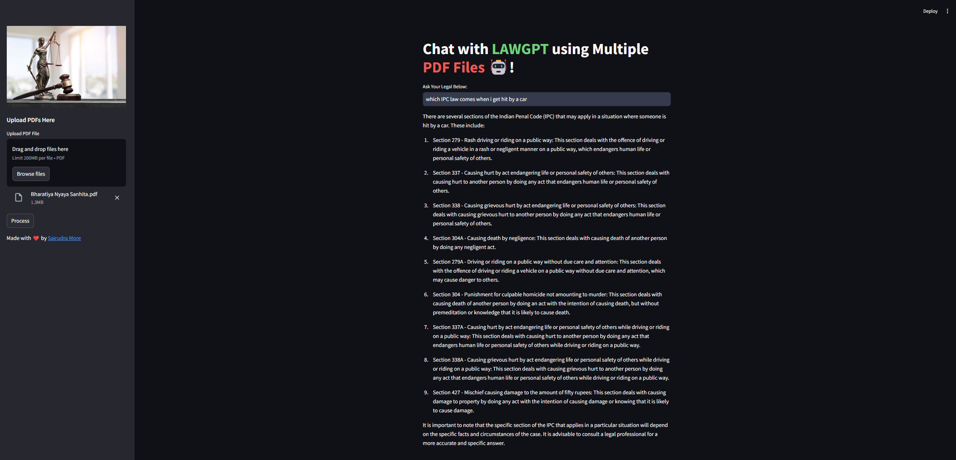
Our Model

Slide 16
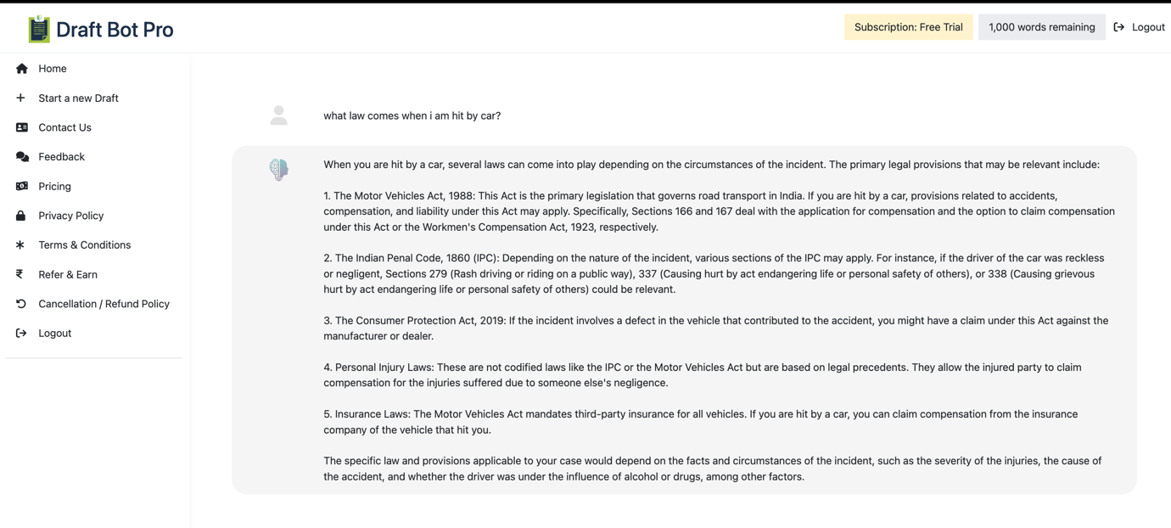
Generic and Incomplete Outputs
Other Models Draft Bot Pro Model (General information only)

Slide 17
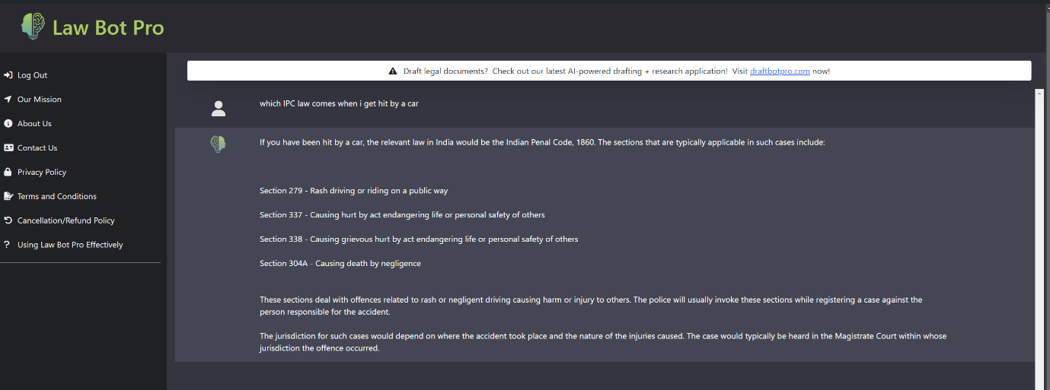
Generic and Incomplete Outputs
Other Models Law Bot Pro Model (very less information)

Slide 18
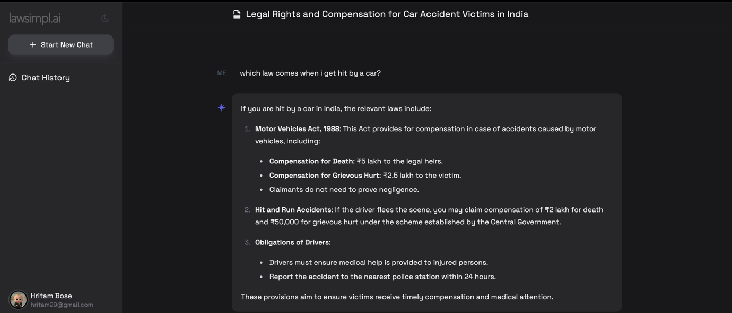
Generic and Incomplete Outputs
Other Models Lawsimpl.ai Model (not in detailed output))

Slide 19
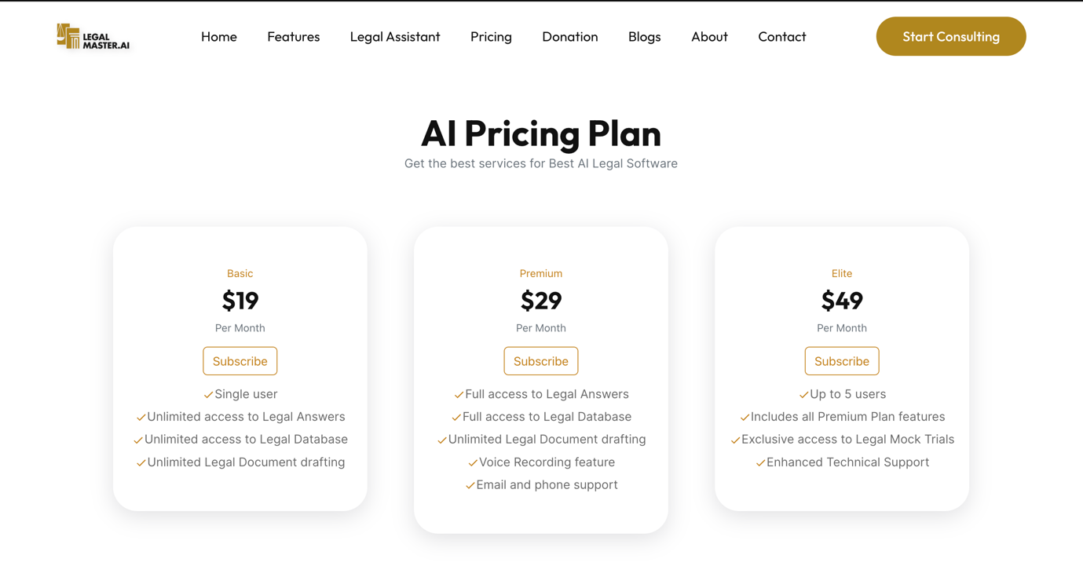
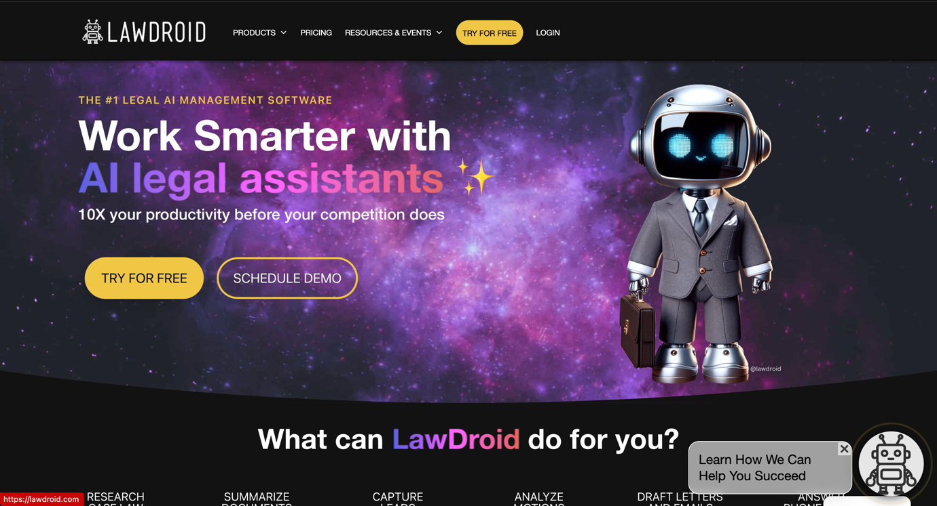
Generic and Incomplete Outputs
Other Models Legal Master.AI Model (Paid service,) LawDroid Model (Paid Service)

Slide 20

Conclusion
LawBots are a significant advancement in the legal field, offering increased accessibility, cost-effectiveness, and efficiency. Our LawBot model stands out with its detailed responses, use of the latest legal codes, and user-friendly interface, making it a superior solution for enhancing public access to legal information and justice.

